Slide 1
Procedural Content Generation in Games
Austin Andrews 3-6-2015

Slide 2
Overview
Introduction & definition
History of Procedural Content Generation (PCG) in games
Then and now comparison
Various usage in current games
Advantages & disadvantages
Demo of Minecraft clone

Slide 3
Methods of Creating Content
Manually creation of content
Artists and developers creating and strategically placing content into games.
Randomly generating content
Getting a random number and assigning a value based on it.
Procedurally creating content
…

Slide 4
What is PCG?
“Procedural Content Generation in games refers to the creation of game content automatically using algorithms” – Julian Togelius
“PCG is the programmatic generation of game content using a random or pseudo-random process that results in an unpredictable range of possible game play spaces” – pcg.wikidot.com
“Procedural is not random. Random potentially creates a mess, while procedural is creating mathematical formulas. The results of the formulas are generated on-the-fly by the computer that hopefully looks correct or hand made” – Sean Murray

Slide 5
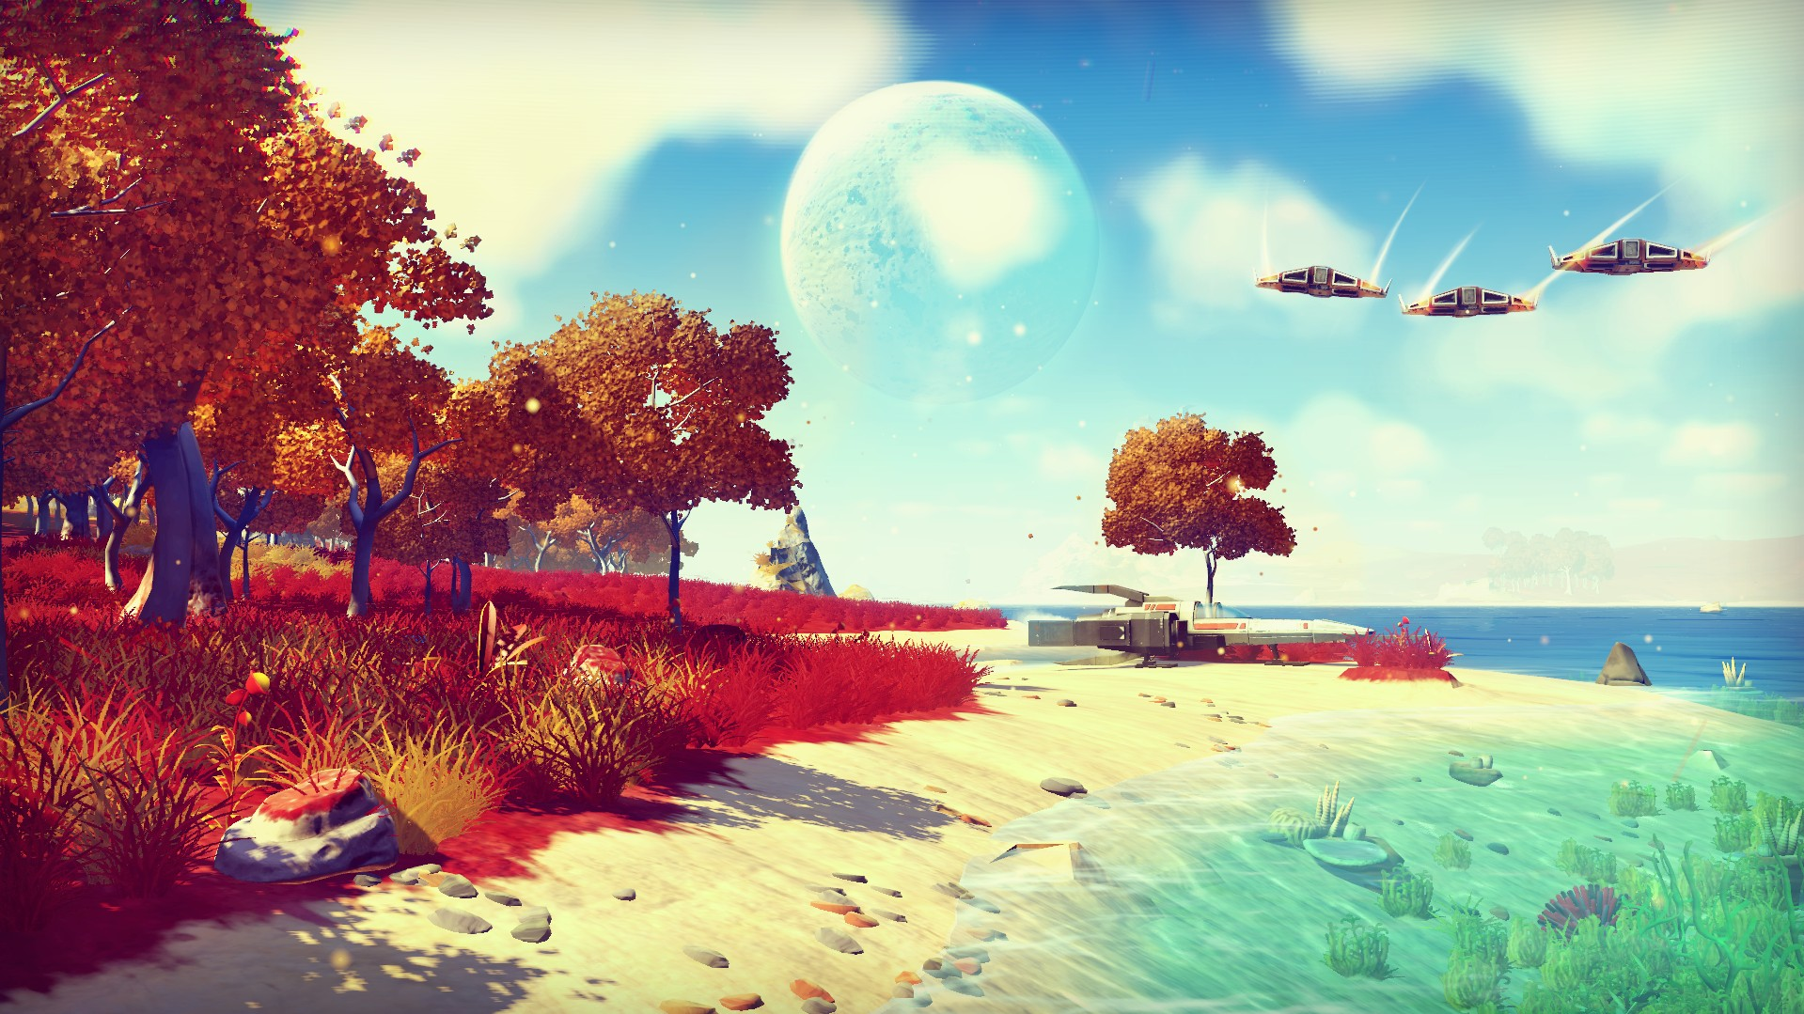
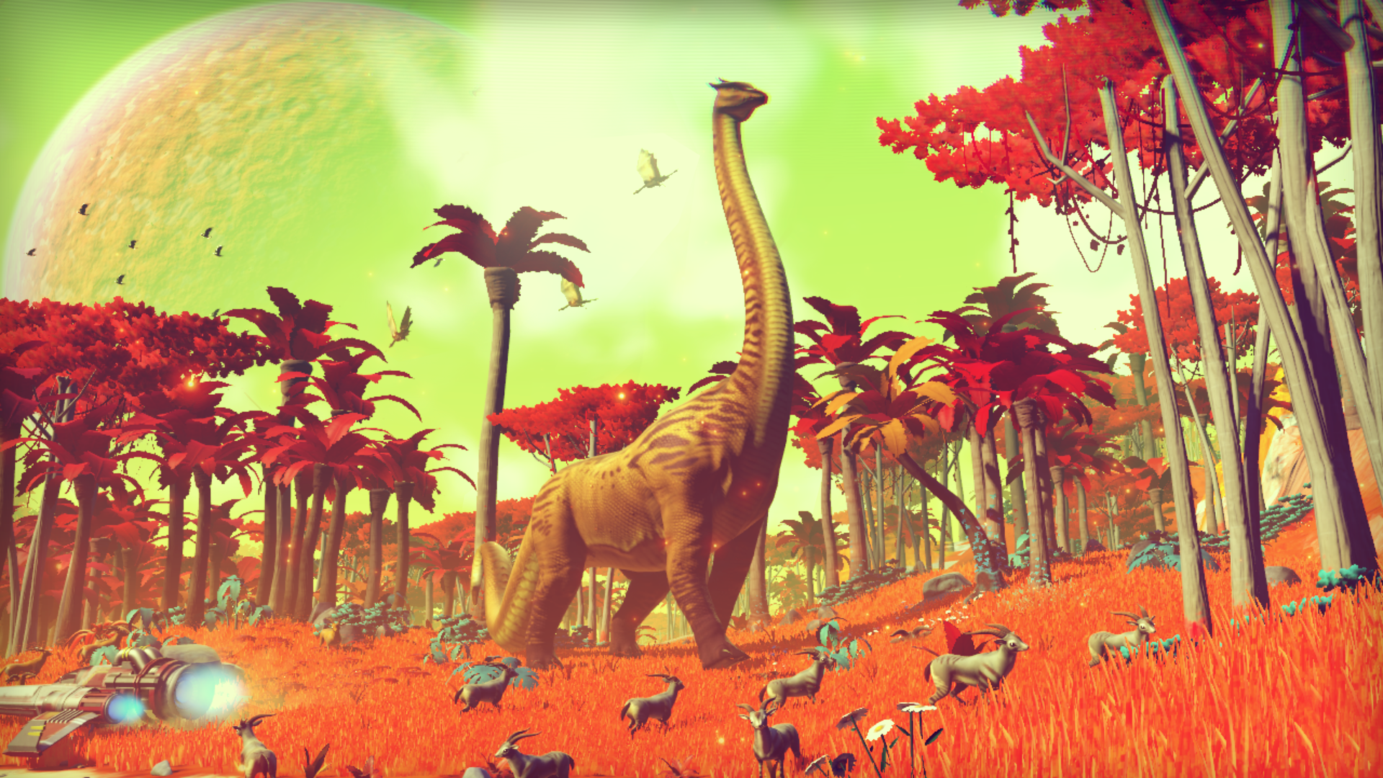
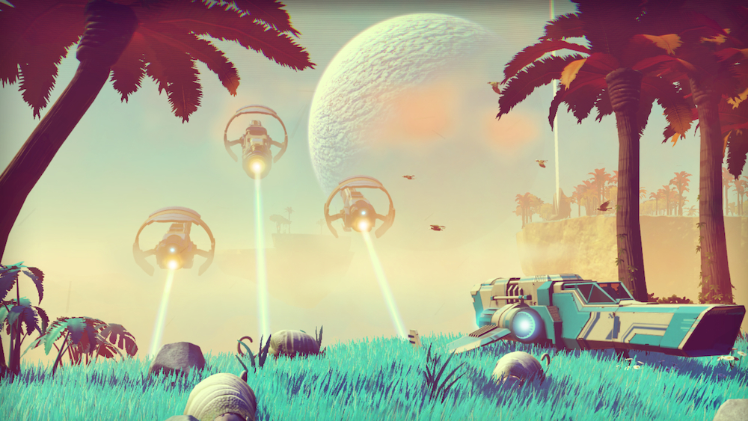
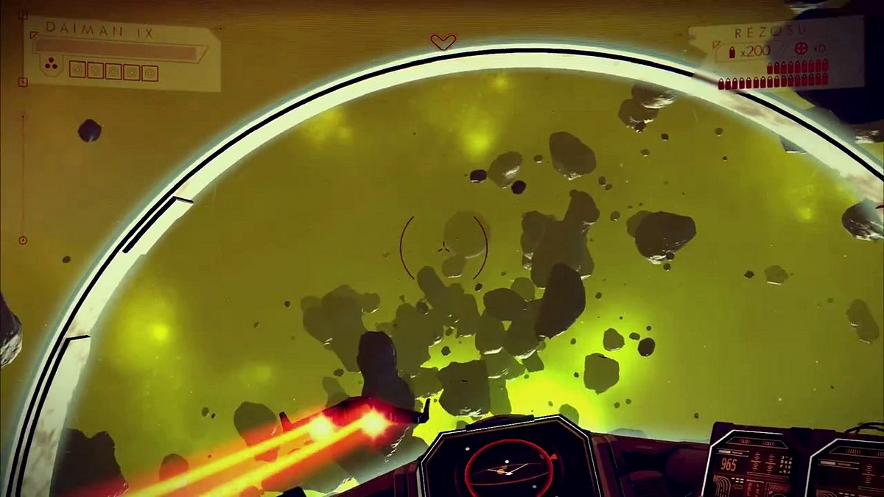
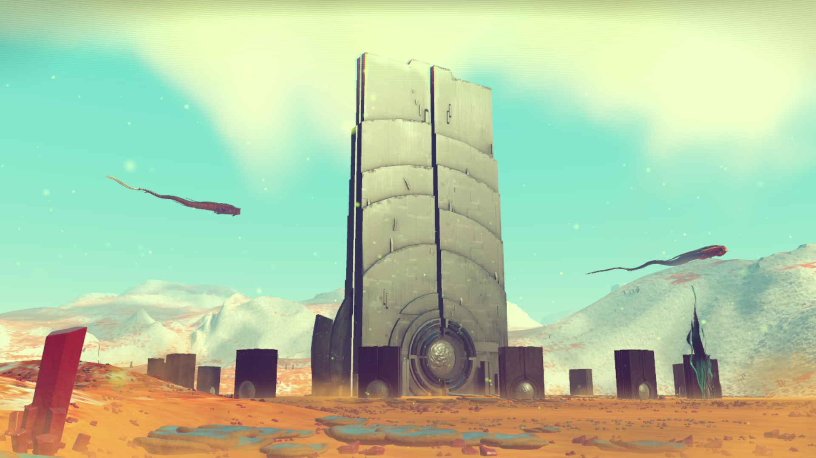
What is PCG? cont..

Slide 6
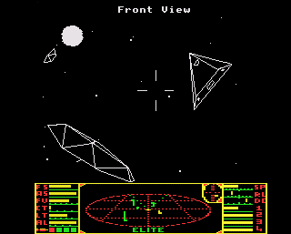
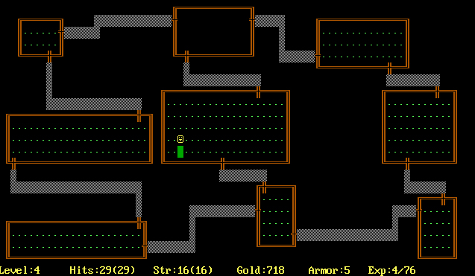
First of Their Kind
Rogue (1983)
Elite (1984)

Slide 7
Rogue
Designed as one of the first PCG games
Generate dungeons procedurally
Spawned its own subgenre: “Roguelike”
“Every time you played, you got a new adventure” – Glenn Wichmann
Due to hardware limitations

Slide 8
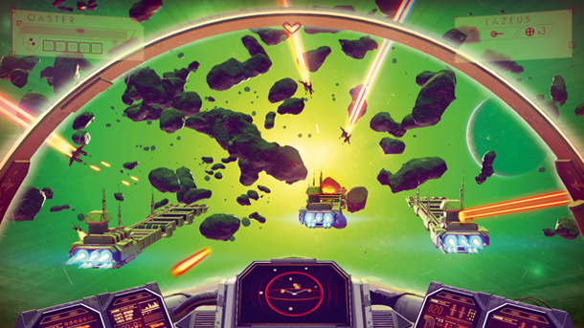
Then and Now
Elite (1984)
No Man’s Sky (2015)
2048 planetary systems spread over 8 galaxies
Uses the seed 23114, 548, 46931
Runs on only 32KBs of memory
18 quintillion visitable planets
Uses a 64 bit seed
Every player is playing on the same instance of the game

Slide 9
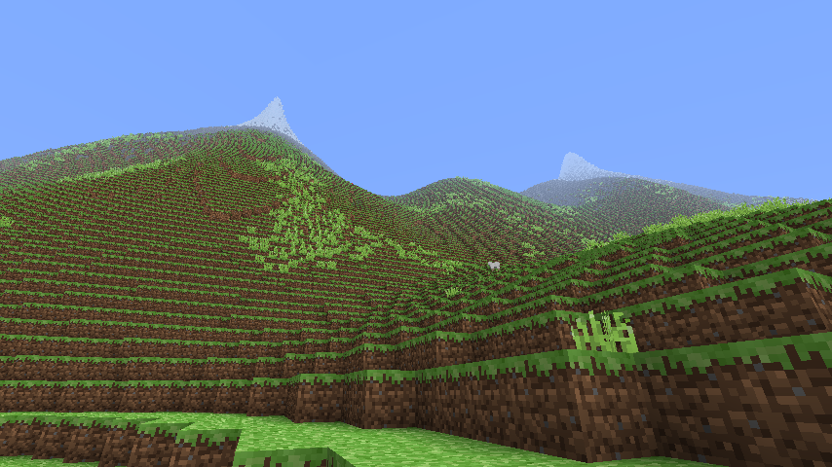
Common Uses of PCG in Games
World Generation
Terrain, planets, galaxies, universes, etc..
Minecraft
Voxel based, chunk loading infinite terrain generator
The world only exists around the player’s current position
The algorithm that determines rendered terrain will provide the same results given the same input, however, anything outside the algorithm’s scope does not exists in memory.

Slide 10
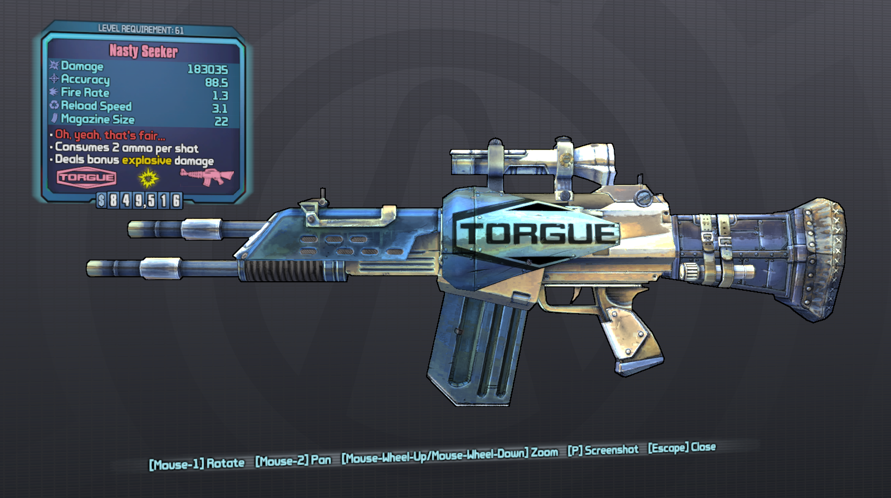
Common Uses of PCG in Games
Item Drops
Borderlands gun generation
“There are over 17,750,000 different variations of weapons in Borderlands” - Gearbox
Impossibility to create that many assets manually
Stats based on player’s levels
Opening chests, finding keys

Slide 11
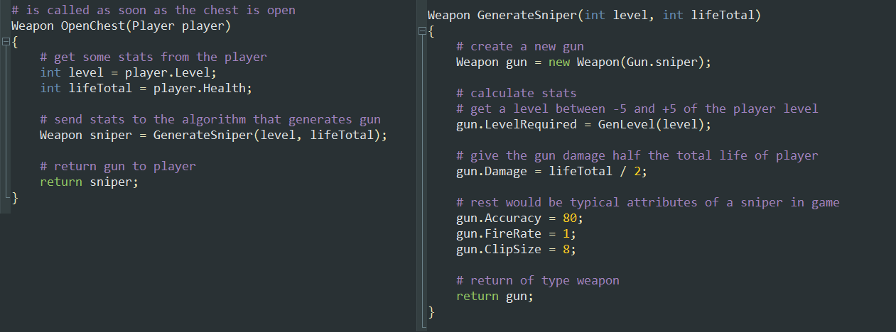
Loot Drop Pseudo-Code

Slide 12
Advantages & Disadvantages
Quantity of required content
Memory management
The future of game’s content can only grow larger and more complicated
Playable worlds can be difficult to construct
Give a player too strong or weak assets
Some view PCG as “lazy” development

Slide 13
Demo

Slide 14
Sources
Gearbox Software. 2009. Boarderlands Wiki. Retrieved from http://boarderlands.wikia.com/wiki/Weapons
Stephen M. Lee-Urban. 2013. Procedural Content Generation. 2013 Georgia Tech Lectures. Retrieved February 4, 2015 from http://www.cc.gatech.edu/~surban6/cs4731/lectures/2013_06_18-ProceduralContentGeneration.pdf
Sean Murray and Cam Robinson. 2014. How Does No Man’s Sky Actually Work? – Reality Check. Video. Retrieved on January 2, 2015 from https://www.youtube.com/watch?v=ZVl1Hmth3HE
Markus Persson (Notch). 2011. The World of Notch, Rarely Updated, Rambling, Ranting, and Informing. Retrieved February 4, 2015 from http://notch.tumblr.com/post/3746989361/terrain-generation-part-1
Rabidgremlin. 2014. Rabidgremlin’s Soapbox – Procedural Content Generation: Creating a Universe. Retrieved February 5, 2015 from http://blog.rabidgremlin.com/2015/01/14/procedural-content-generation-creating-a-universe/
Julian Togelius. 2011. What is Procedural Content Generation? Mario on the Borderline. Retrieved February 17, 2015 from http://julian.togelius.com/Togelius2011What.pdf
Pcg.wikidot.com. 2014. Procedural Content Generation Wiki. Retrieved January 5, 2015 from http://pcg.wikidot.com

